Slide 1
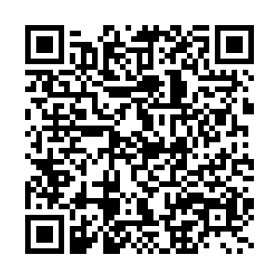

Slide 2
Challenging Power & Data Neutrality
Collect
Analyze
Imagine
Teach

Slide 3
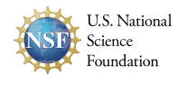
One mechanism of federal funding for the sciences – this includes the social, physical, and life sciences.

Slide 4
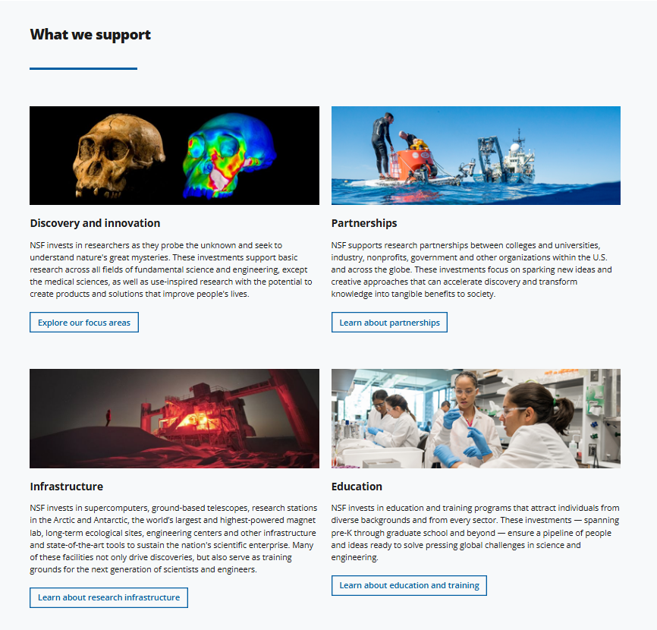

Slide 5
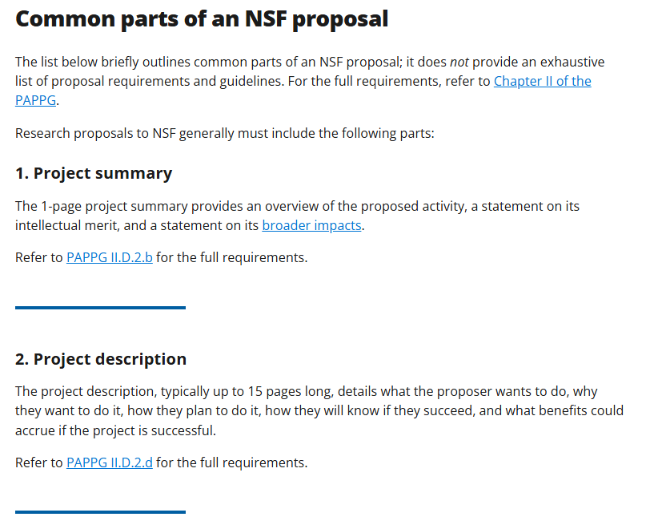

Slide 6
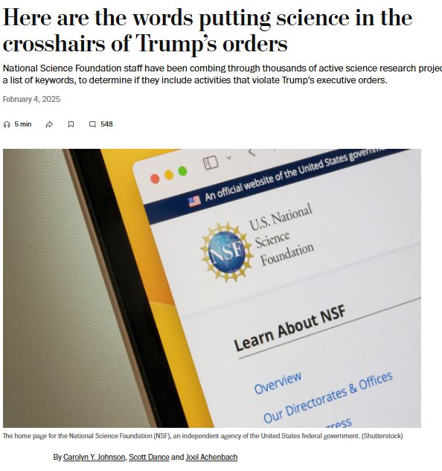
Notes:
https://www.washingtonpost.com/science/2025/02/04/national-science-foundation-trump-executive-orders-words/

Slide 7
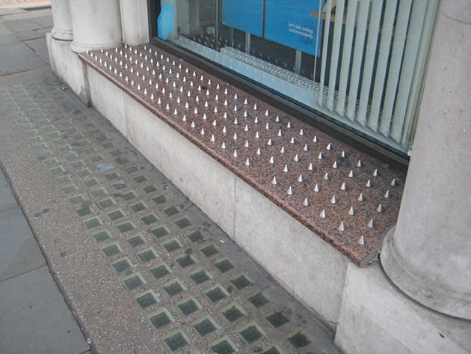
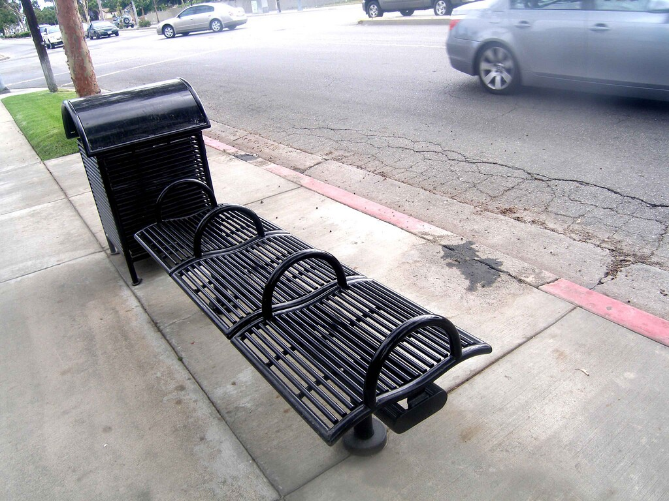

Discriminatory Design
Notes:
https://www.propublica.org/article/discrimination-by-design

Slide 8

New Jim Code

Slide 9



